Slide 1

FT6x06 Capacitive Touch Driver
By: Karan Raj kanwar

Slide 2
Proposal
The point of the project is to create a portable display that showcase’s the database data in a clean UI which explains current or previous track record. The track record consists of source of transportation, average speed ,date, and the screens touch's. The app will allow the dashboard UI to be customized, or the mobile device itself can be used as the digital dashboard.

Slide 3
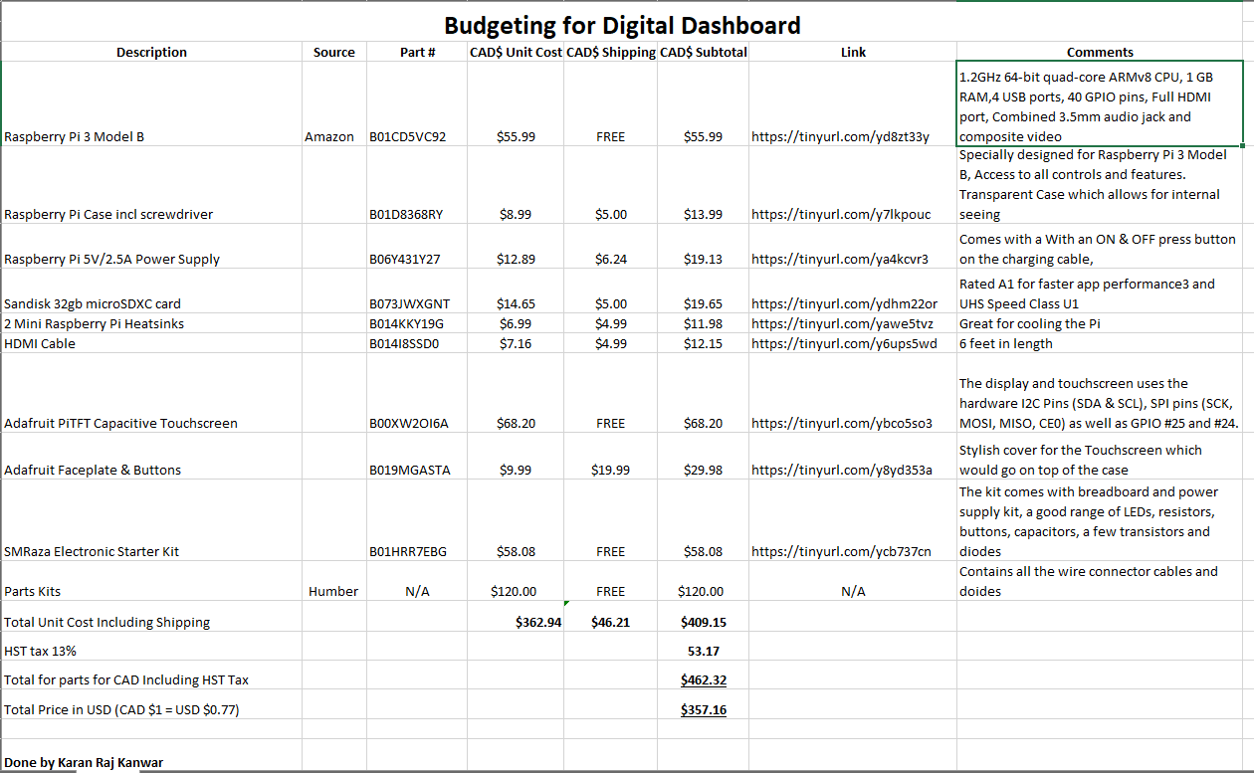
Budget

Slide 4
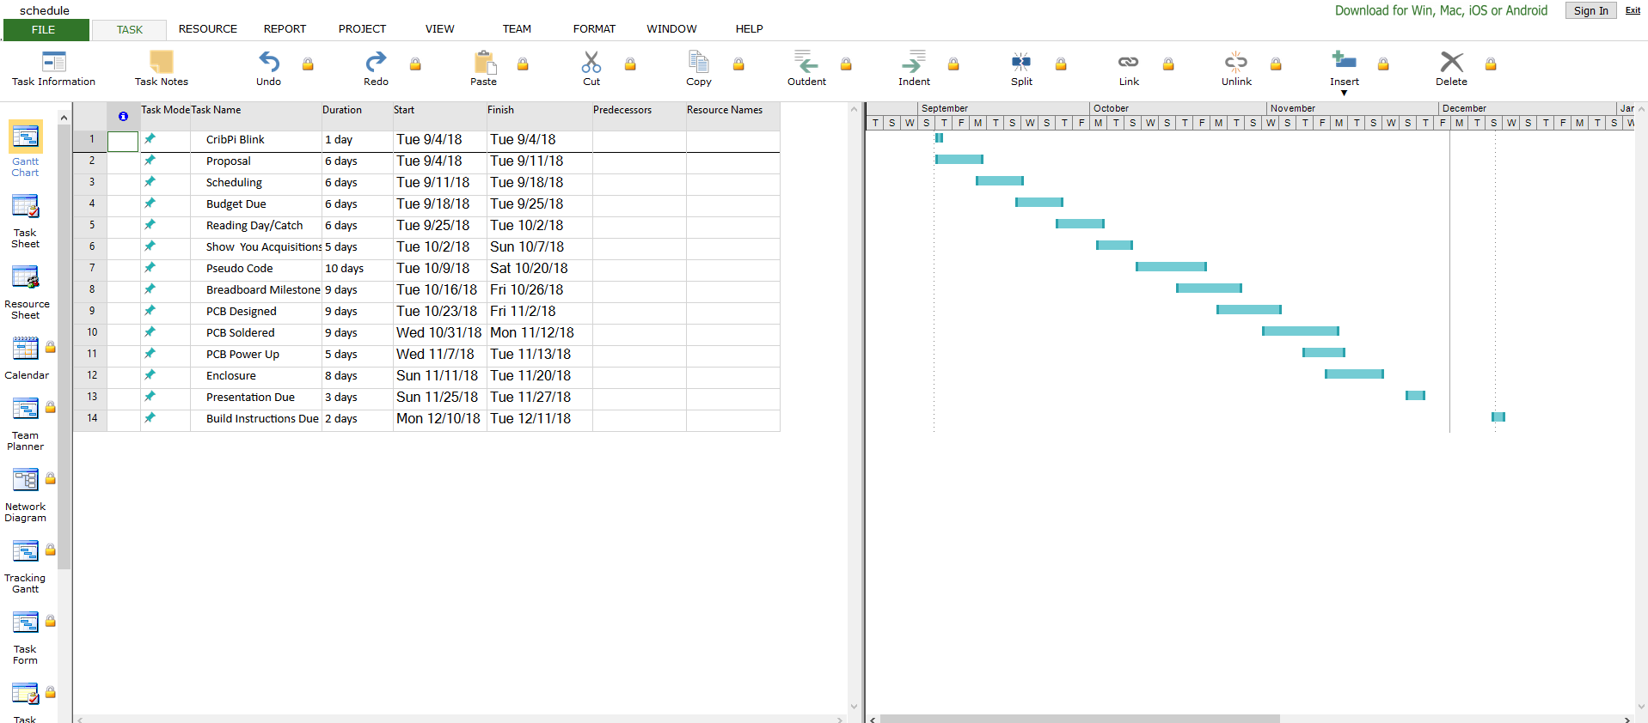
Schedule

Slide 5
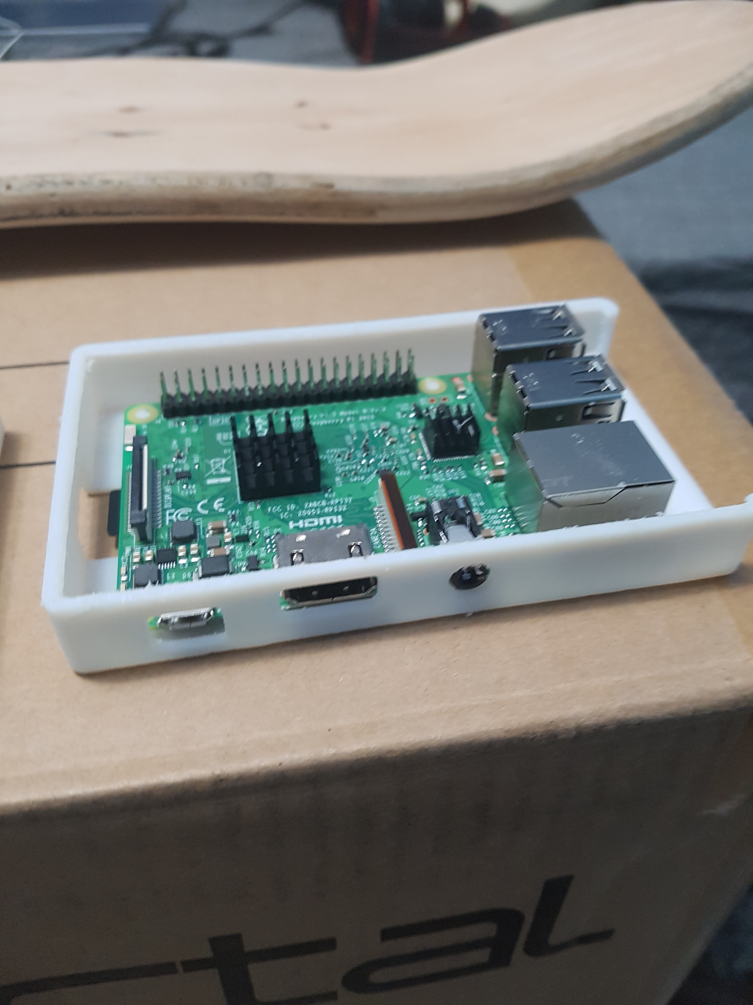
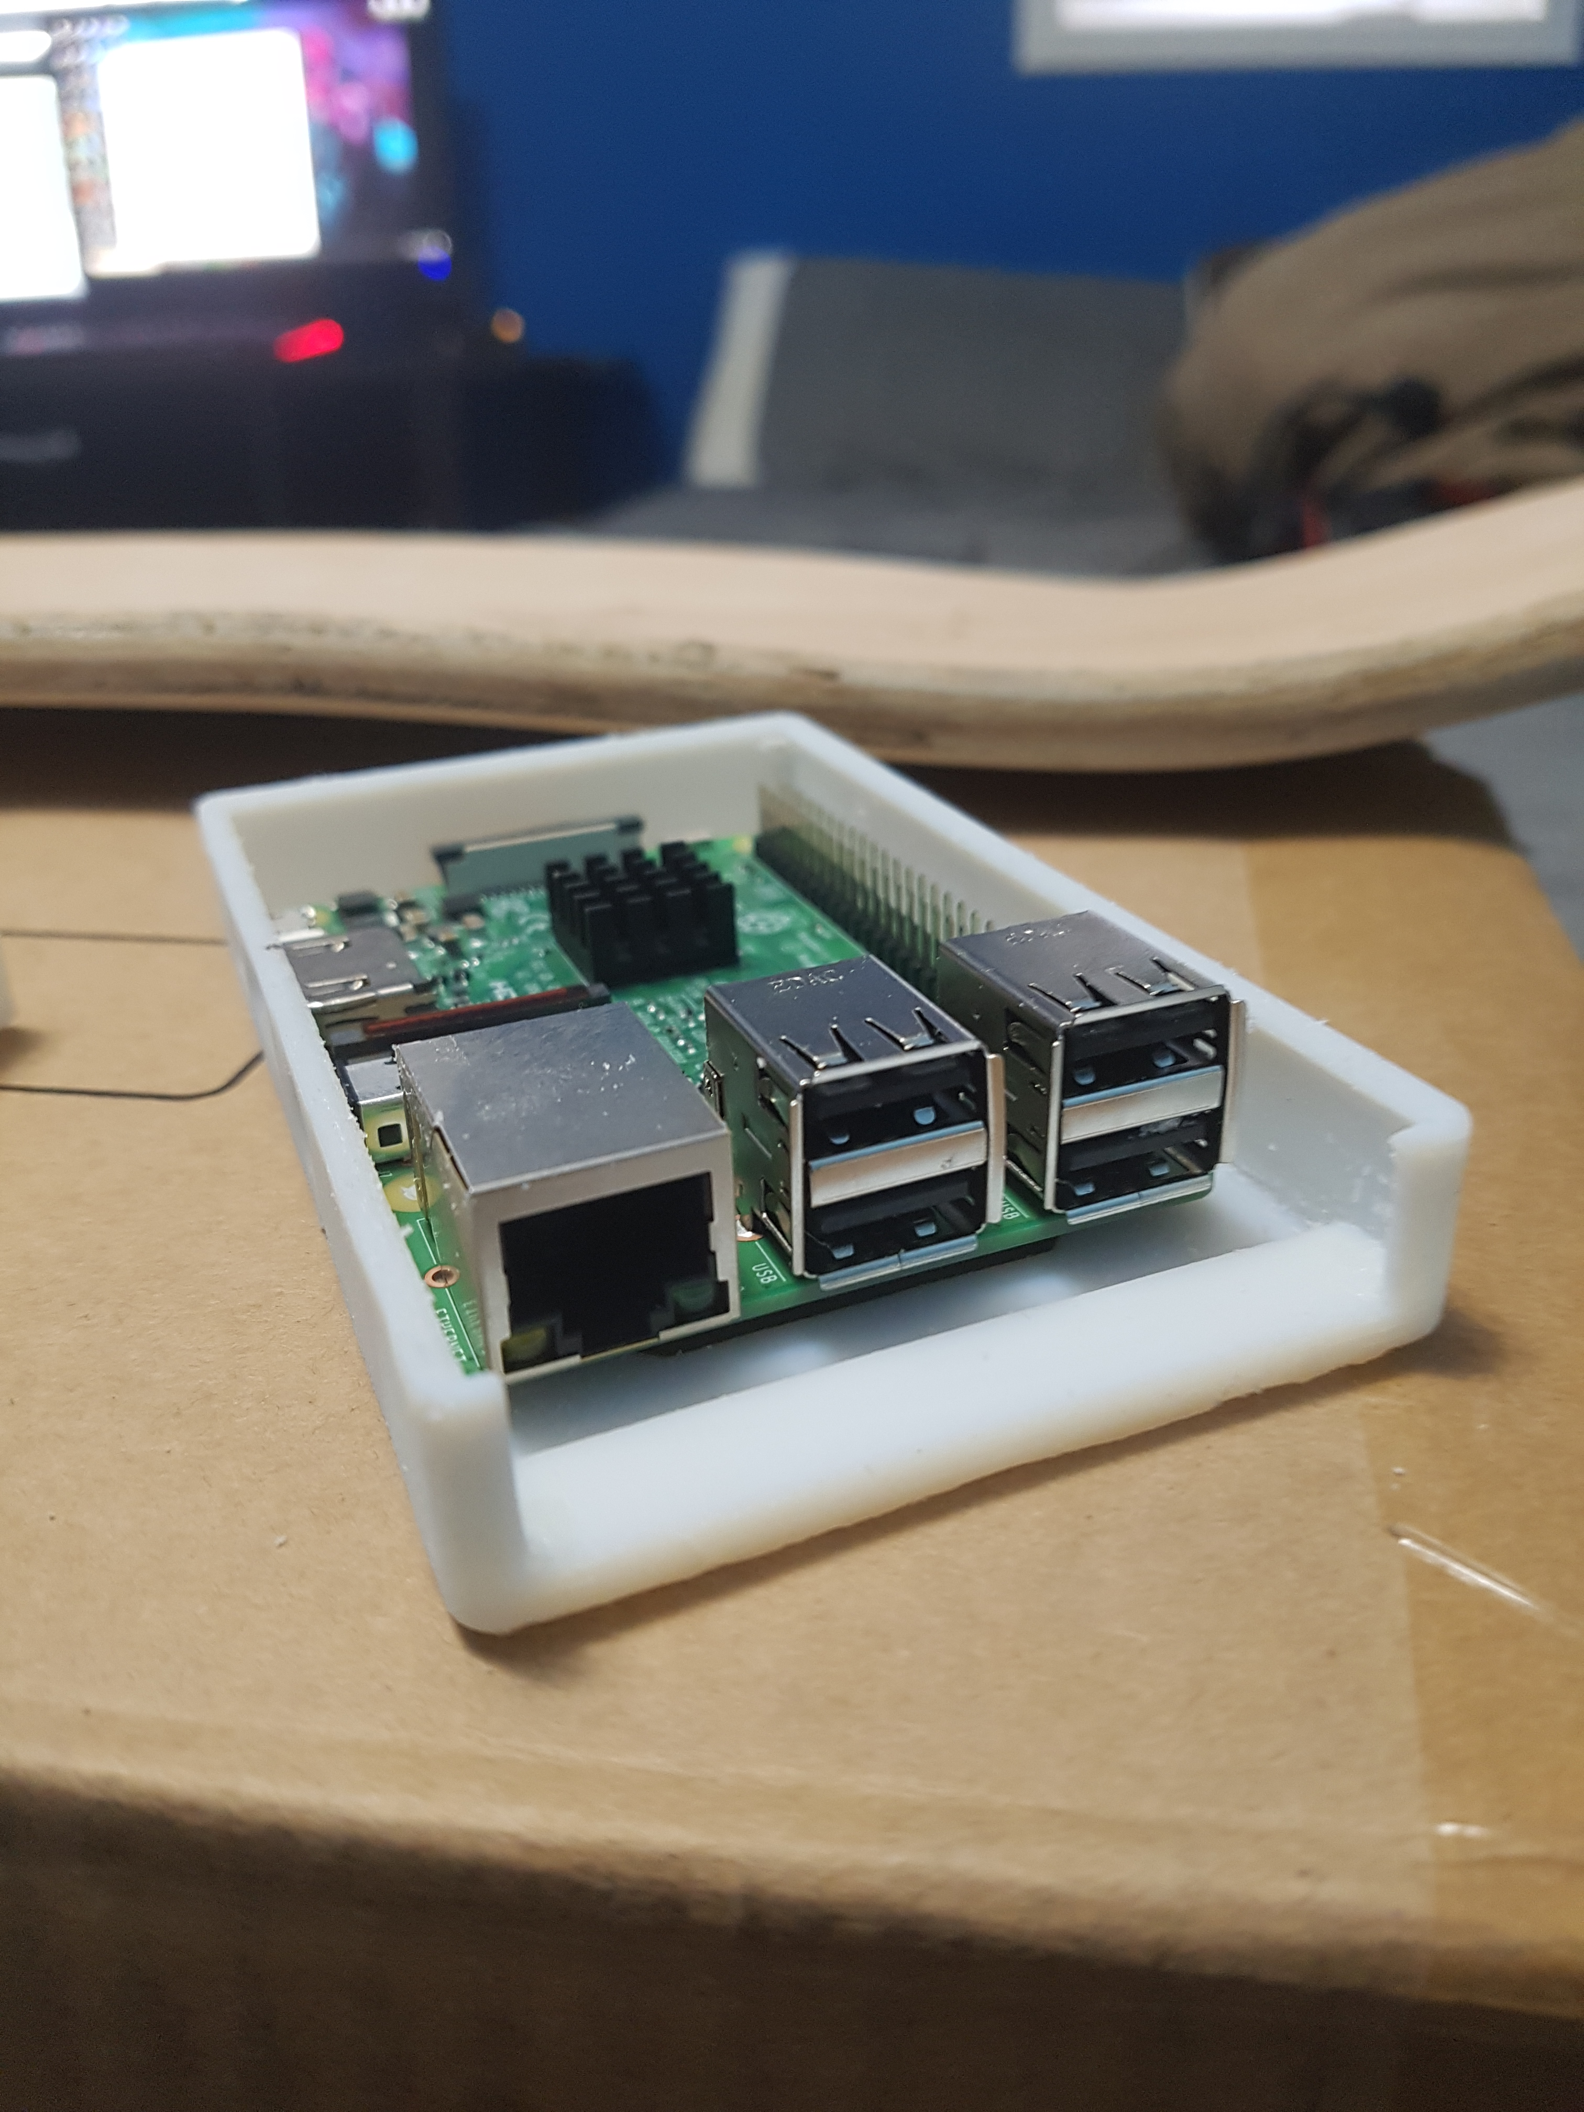
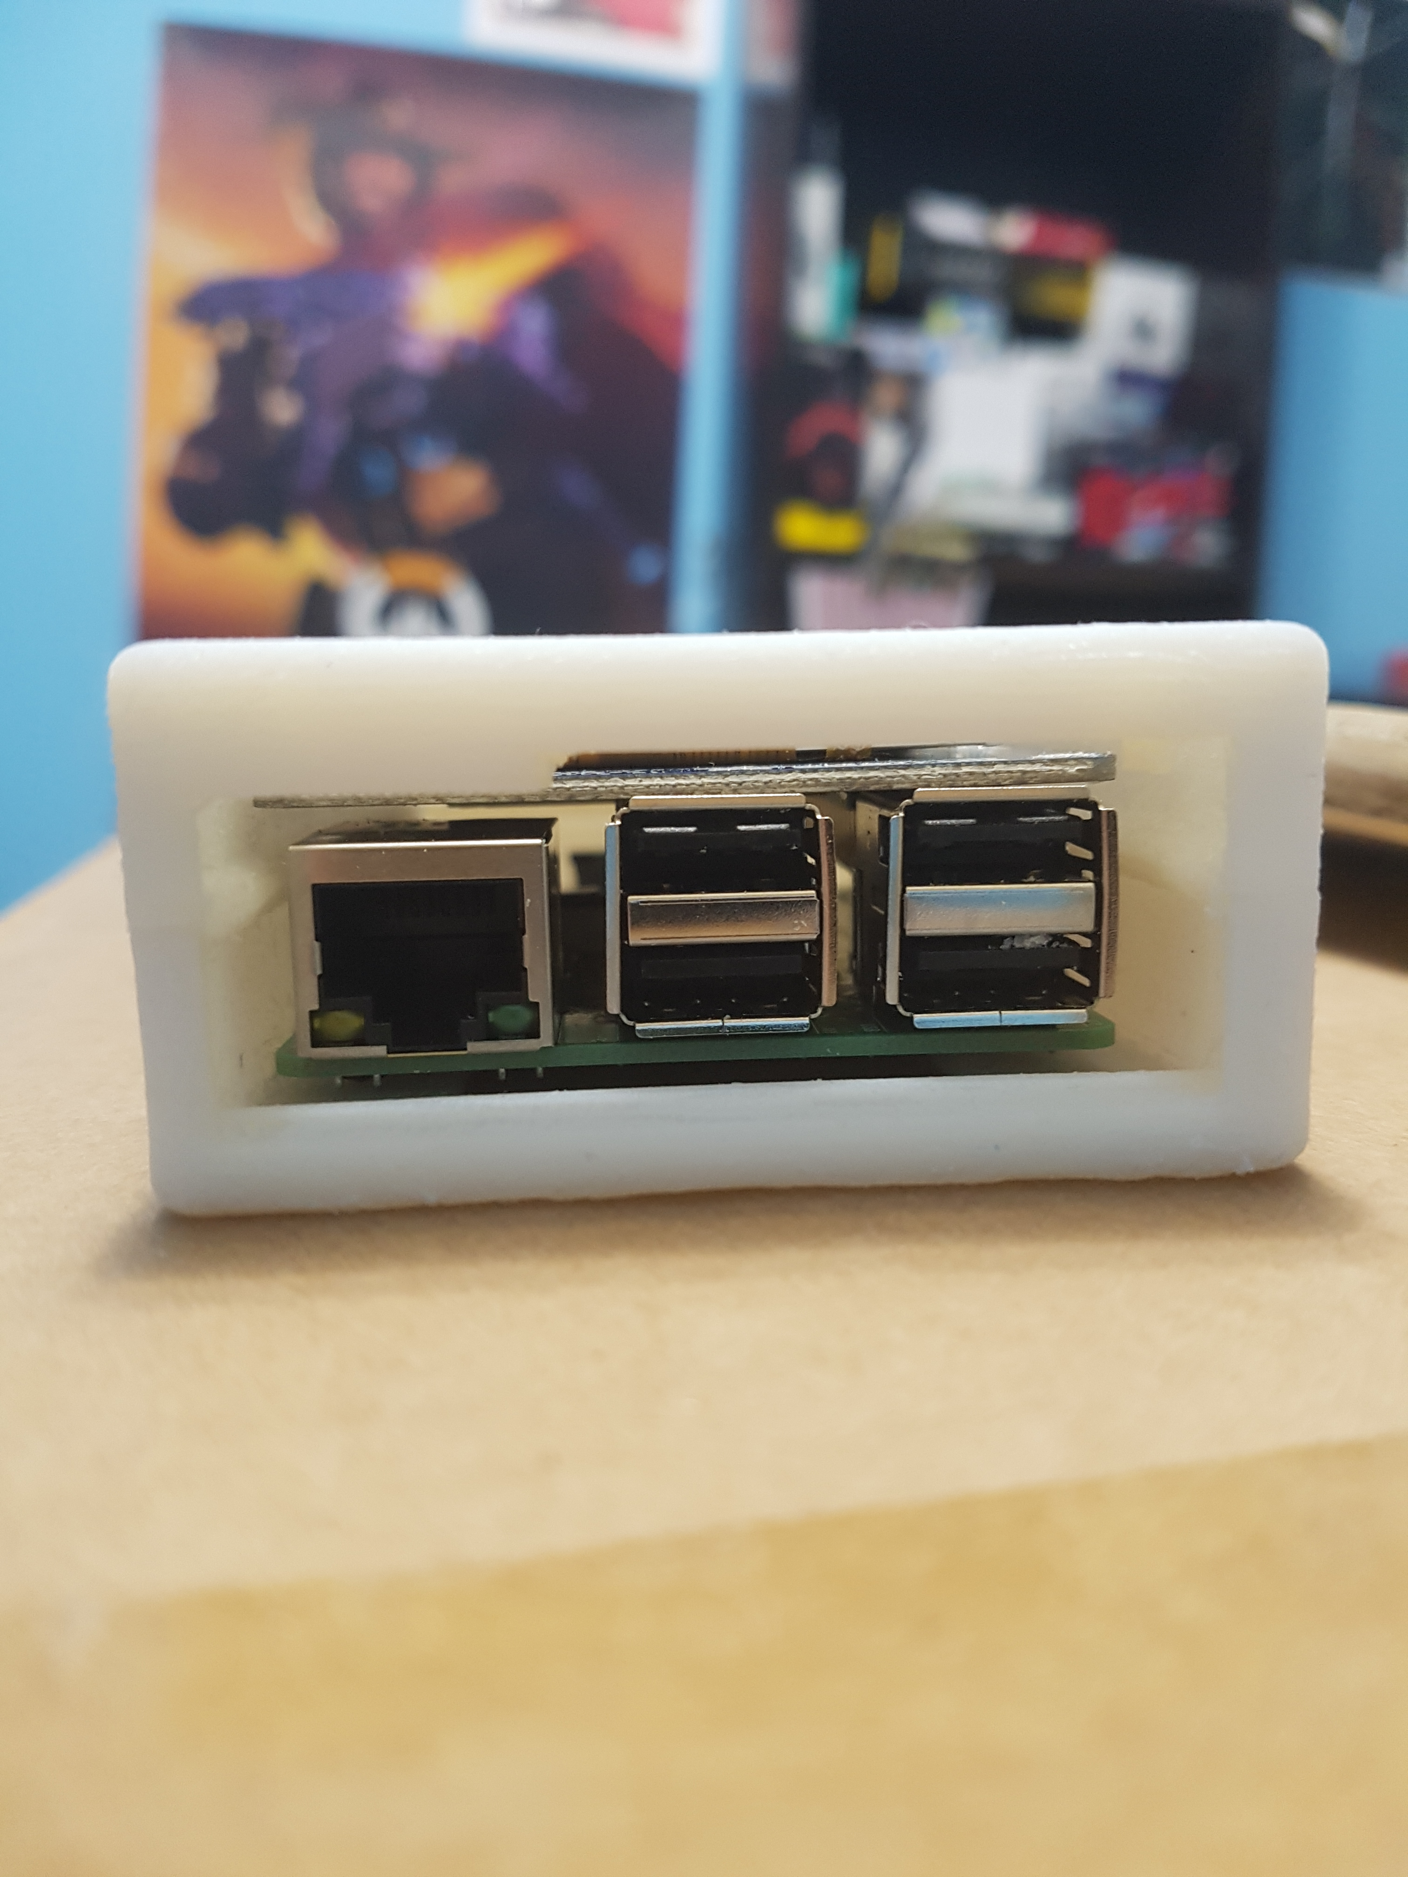
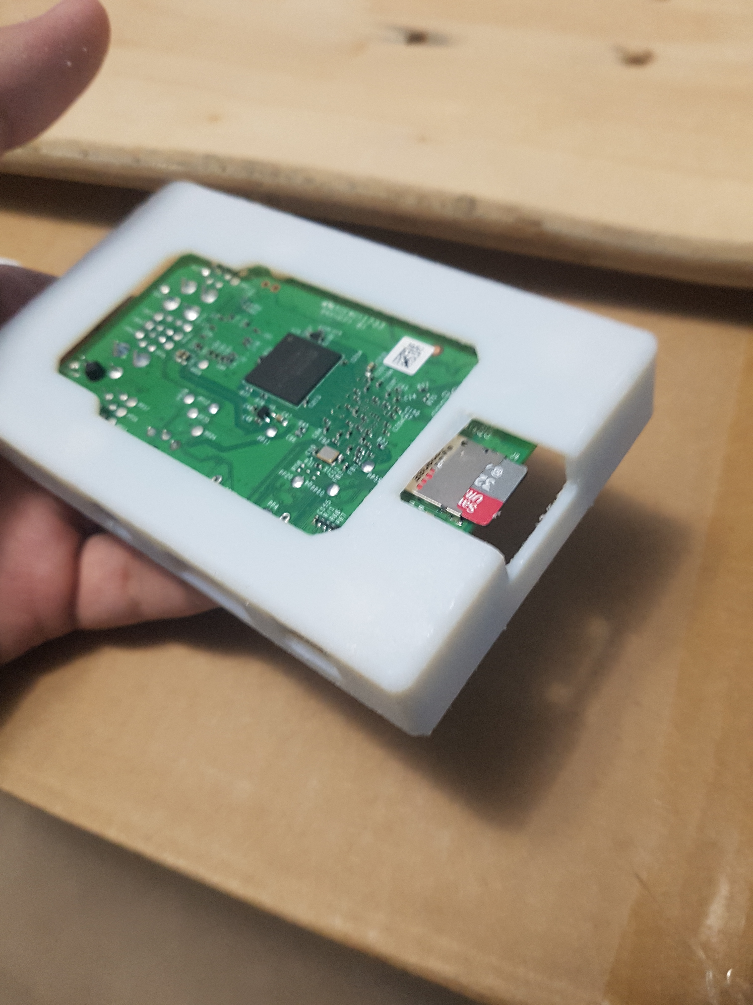
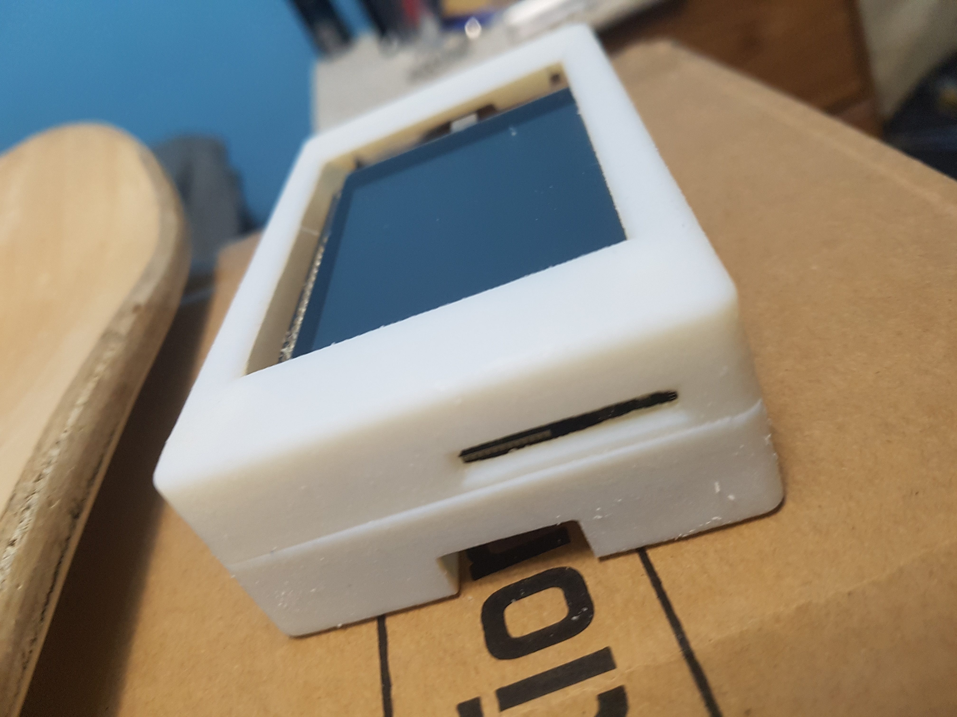
Enclosure

Slide 6
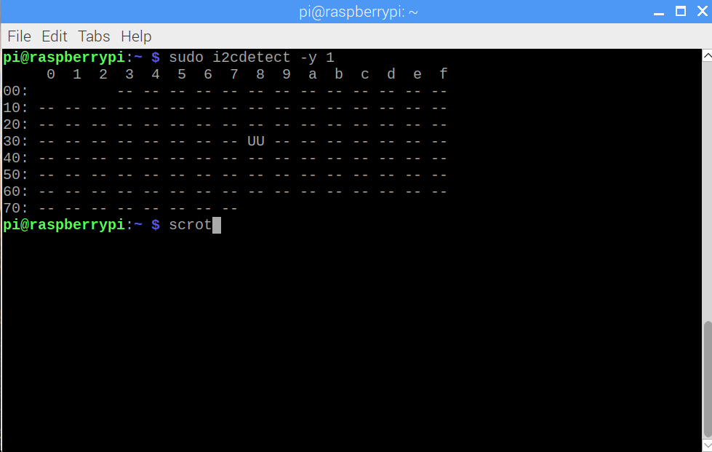
My device I2c address

Slide 7
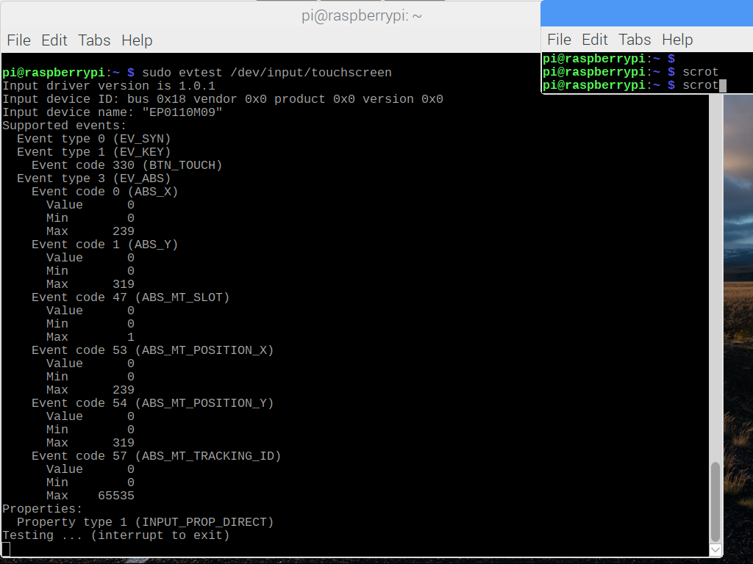
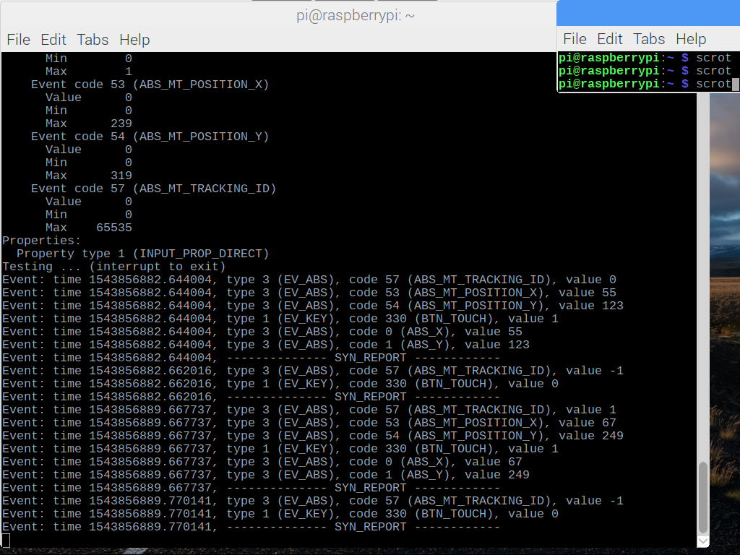
Touchscreen event demonstration

Slide 8
Previous Course Knowledge
CENG 252 – Embedded Systems –we used the BME 280 and the raspberry pi. Most of the knowledge I have on the raspberry pi is from that course. Understanding VNC, navigating around its file system and running programs on it.
WRIT 220 – Writing Skills - We wrote technical documents and research reports with the appropriate sources, content and layout. This helped me for when creating the weekly blog
CENG 251 – UNIX Internals – We learned UNIX commands and how to navigate though terminal with ease. This came in handy when I was configuring my Pi for the first time.

Slide 9
Thank You For Listening

